Slide 1
Students in the Civil Rights Movement: Kelly Ingram Park Virtual Tour
How did students and children participate in the Civil Rights movement?

Slide 2
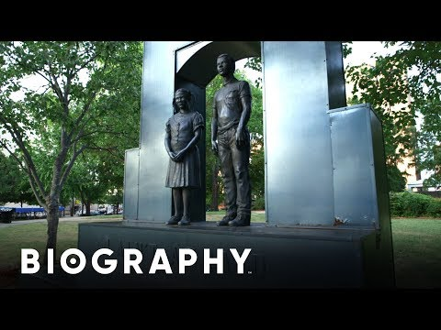
How did students and children participate in the Civil Rights Movement?

Slide 3
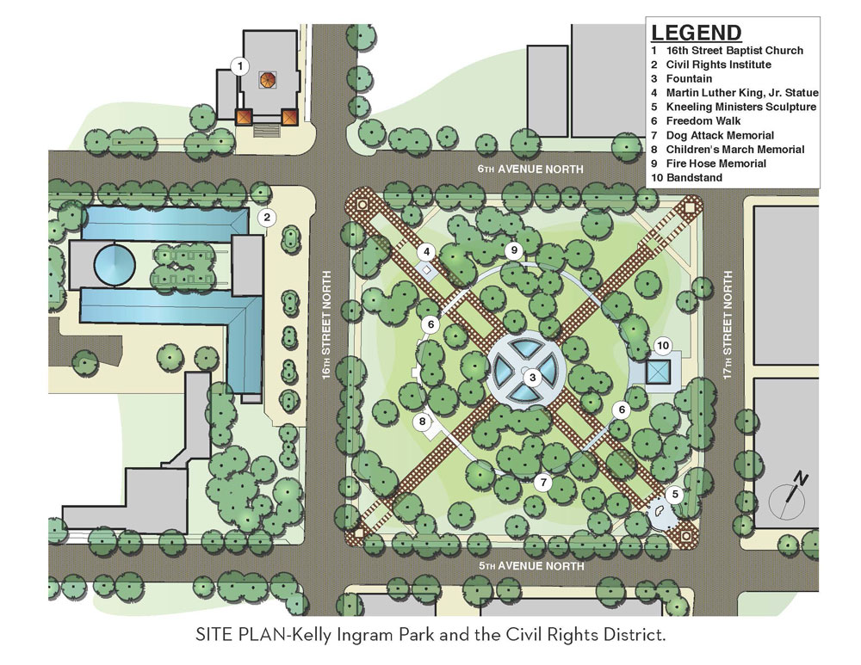
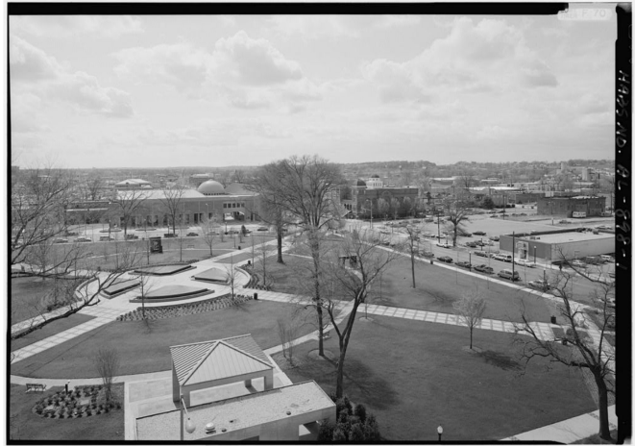
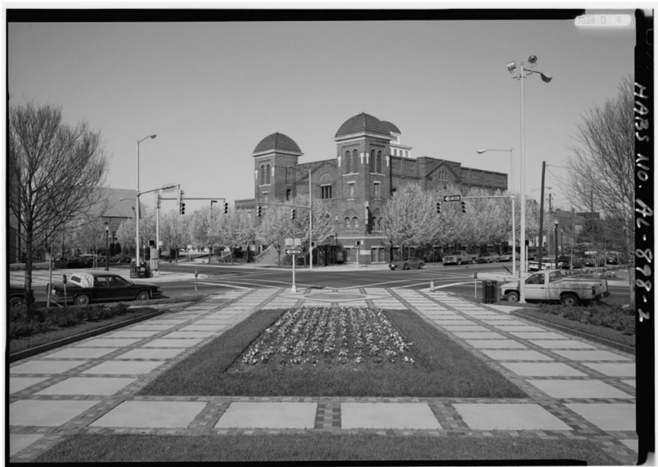
Kelly Ingram Park Overview
Kelly Ingram Park
16th Street Baptist Church
8
4
Site 1: Ground Zero
Site 2: The Foot Soldiers
Site 3: Children’s Crusade
Site 4: Water Cannons
Site 5 Reflection Pool
Site 8: Four Little Girls
3
5
2
1
Notes:
Image Attributions:
American Society of Landscape Architects Alabama Chapter. (n.d.) Kelly Ingram Park. Alabama ASLA. https://web.archive.org/web/20221216203421/https://www.alabamaasla.com/portfolio_page/kelly-ingram-park/. All rights reserved.
Historic American Buildings Survey, C., Rayfield, W. A., Windham, T. C., Windham Brothers Construction Company, L. L. Samms And Sons Company, Shuttlesworth, F. L. [...] Clark, S. C., Lowe, J. (1933). Sixteenth Street Baptist Church, Sixth Avenue North, Birmingham, Jefferson County, AL. Alabama Birmingham Jefferson County, 1933. McPartland, M., trans Documentation Compiled After [Photograph]. Library of Congress. https://www.loc.gov/item/al0966/. Public domain (CC0).
Historic American Buildings Survey, C., Rayfield, W. A., Windham, T. C., Windham Brothers Construction Company, L. L. Samms And Sons Company, Shuttlesworth, F. L. [...] Clark, S. C., Lowe, J. (1933). Sixteenth Street Baptist Church, Sixth Avenue North, Birmingham, Jefferson County, AL. Birmingham Jefferson County Alabama, 1933. McPartland, M., trans Documentation Compiled After [Photograph]. Library of Congress. https://www.loc.gov/item/al0966/. Public domain (CC0).

Slide 4
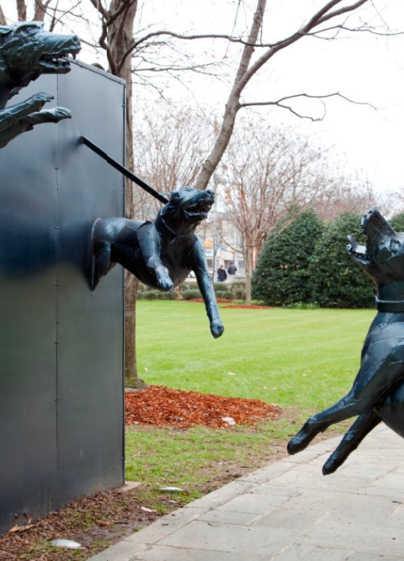
Site 1: Ground Zero Listen Here
Next
Notes:
Alternative Method for Listening (Dial In):
Using your phone, call 205-307-5455
When prompted, press 1
Image Attribution:
Highsmith, C. M. (2010a). Kelly Ingram Park, Birmingham, Alabama. Alabama Birmingham United States, 2010. March 3 [Photograph]. Library of Congress. https://www.loc.gov/item/2010636980/. Public domain (CC0).

Slide 5
Site 1: Ground Zero
What were some of the issues that protesters were fighting against?
Back to Map

Slide 6
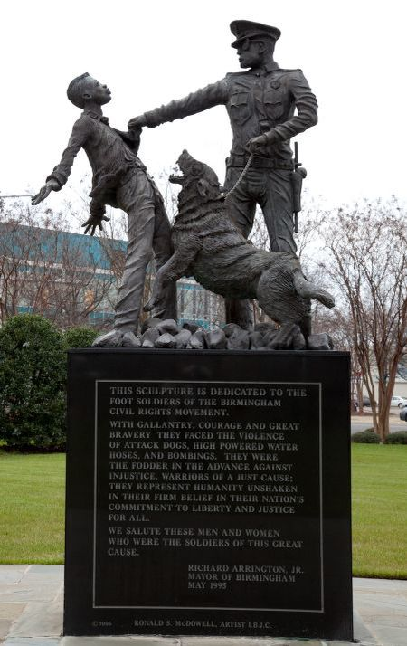
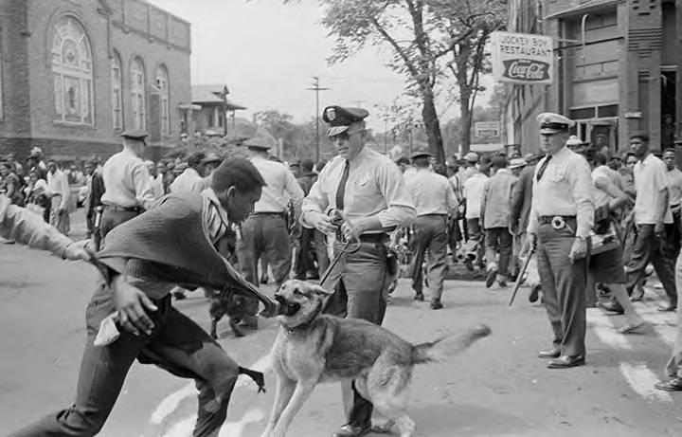
Site 2: The Footsoldiers Listen Here
Next
Notes:
Alternative Method for Listening (Dial In):
Using your phone, call 205-307-5455
When prompted, press 2
Image Attributions:
Highsmith, C. M. (2010b). Sculpture dedicated to the foot soldiers of the Birmingham civil rights movement. Kelly Ingram Park, Birmingham, Alabama [Photograph]. Library of Congress. https://www.loc.gov/resource/highsm.05111/. Public domain (CC0).
Alabama Media Group (1963). Police dog attacking Walter Gadsden, a student at Parker High School, during a civil rights demonstration in downtown Birmingham, Alabama [Photograph]. Alabama Department of Archives and History. https://digital.archives.alabama.gov/digital/collection/amg/id/14478/rec/3. All rights reserved.

Slide 7
Site 2: The Foot Soldiers
Who are the foot soldiers of the Civil Rights Movement?
According to the tour, Southern Christian Leadership Conference (SCLC) leaders had “an ace up their sleeve.” Make a prediction: what was that “ace?”
Back to Map

Slide 8
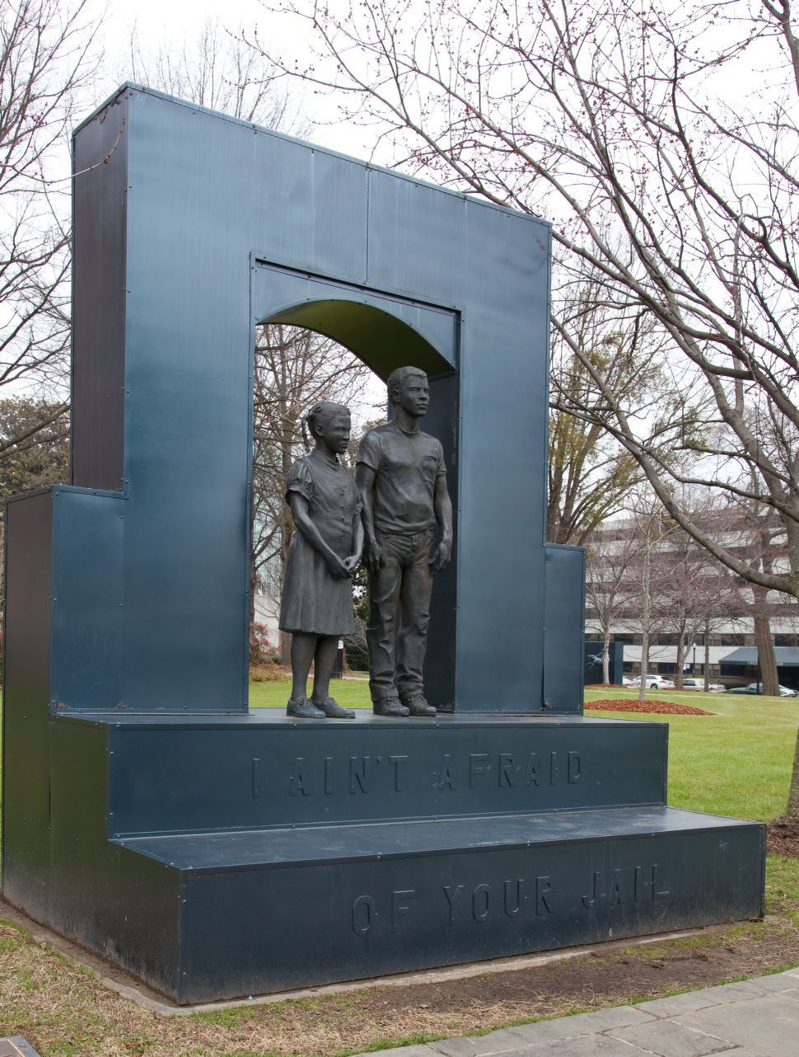
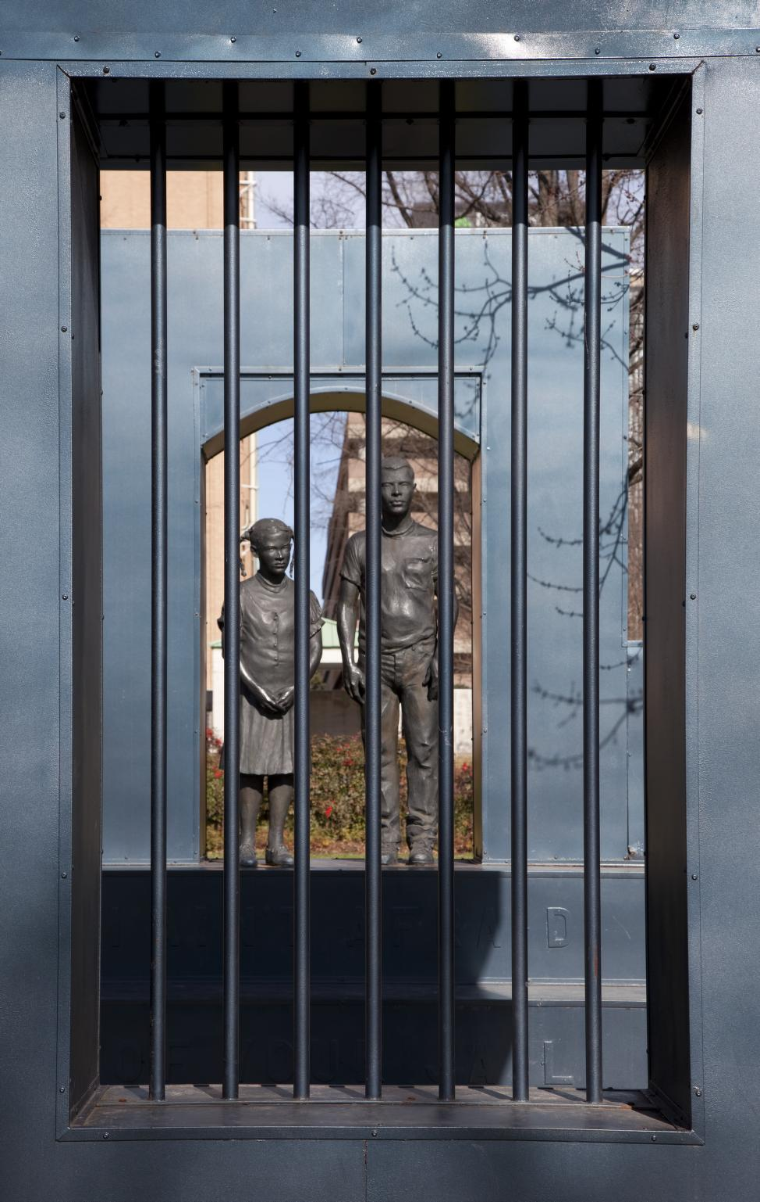
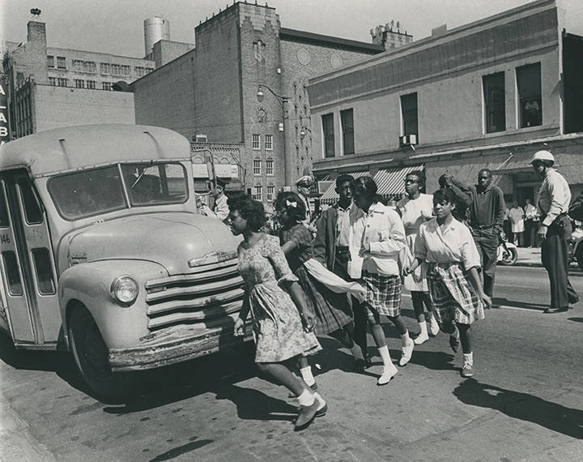
Site 3: Children’s Crusade Listen Here
Next
Notes:
Alternative Method for Listening (Dial In):
Using your phone, call 205-307-5455
When prompted, press 3
Image Attributions:
Highsmith, C. M. (2010c). Kelly Ingram Park, Birmingham, Alabama [Photograph]. Library of Congress. https://www.loc.gov/resource/highsm.05112/. Public domain (CC0).
Highsmith, C. M. (2010d). Kelly Ingram Park, Birmingham, Alabama [Photograph]. Library of Congress. https://www.loc.gov/resource/highsm.05056/. Public domain (CC0).
Alabama Media Group (1963). Civil rights demonstrators being arrested on 3rd Avenue North in downtown Birmingham, Alabama, during the Children's Crusade [Photograph]. Alabama Department of Archives and History. https://digital.archives.alabama.gov/digital/collection/amg/id/206452/rec/16. All rights reserved.

Slide 9
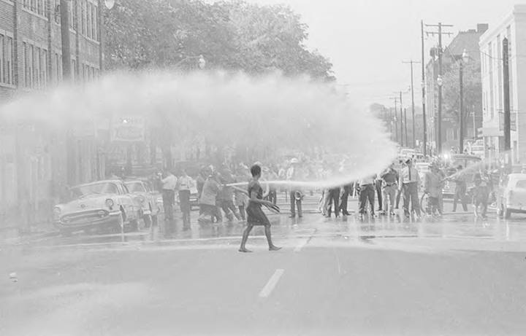
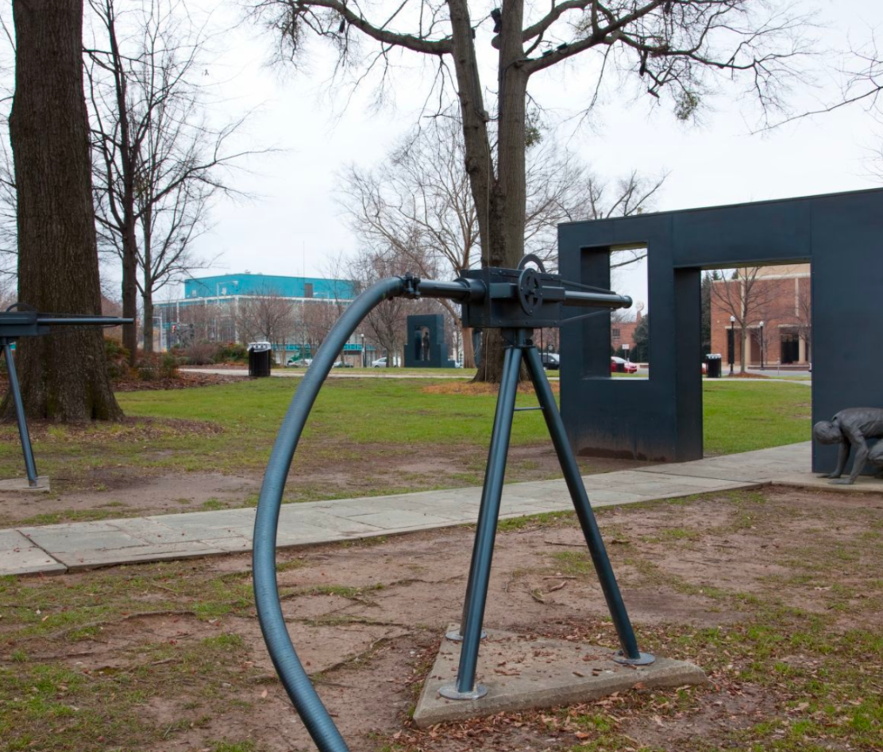
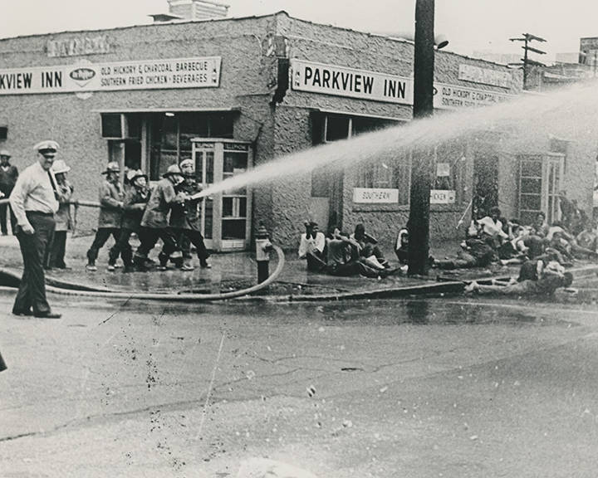
Site 4: Water Cannons Listen Here
Next
Notes:
Alternative Method for Listening (Dial In):
Using your phone, call 205-307-5455
When prompted, press 4
Image Attributions:
Alabama Media Group (1963). Firemen spraying civil rights demonstrators with fire hoses in downtown Birmingham, Alabama [Photograph]. Alabama Department of Archives and History. https://digital.archives.alabama.gov/digital/collection/amg/id/14127/rec/5. All rights reserved.
Highsmith, C. M. (2010e). Kelly Ingram Park, Birmingham, Alabama [Photograph]. Library of Congress. https://www.loc.gov/item/2010636978/. Public domain (CC0).
Alabama Media Group (1963). Firemen spraying civil rights demonstrators with fire hoses in front of the Parkview Inn in downtown Birmingham, Alabama, during the Children's Crusade [Photograph]. Alabama Department of Archives and History. https://digital.archives.alabama.gov/digital/collection/amg/id/206443/rec/6. All rights reserved.

Slide 10
Site 3: Children’s Crusade Statue & Site 4: Water Cannons
What action did Bull Connor take against the students and children?
Why did the student marchers “[keep] coming” in the face of police dogs and water cannons? What was the intent of the foot soldiers and organizers?
Back to Map

Slide 11
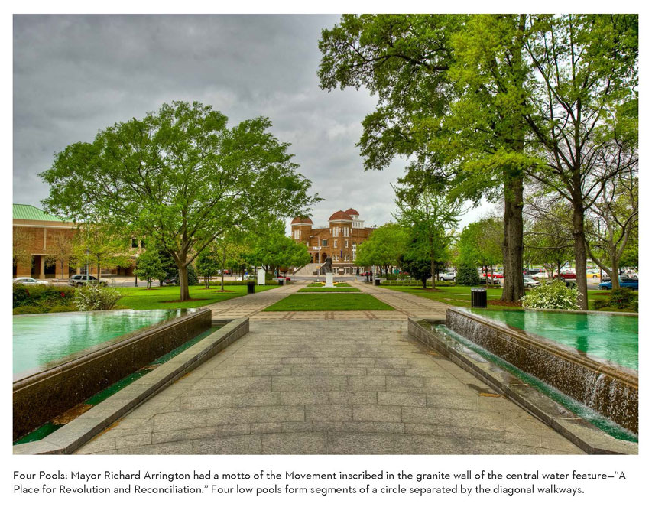
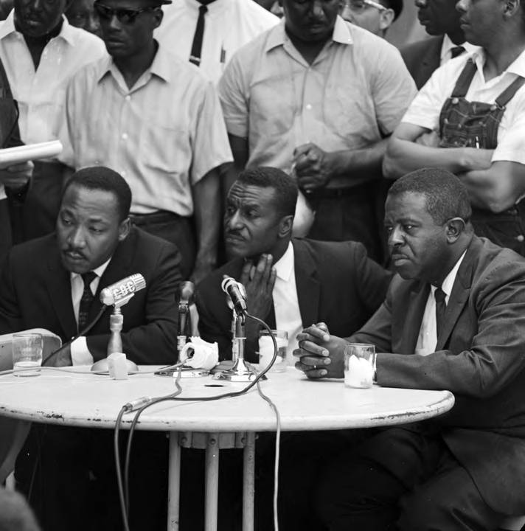
Site 5: Reflecting Pool Listen Here
Next
Notes:
Alternative Method for Listening (Dial In):
Using your phone, call 205-307-5455
When prompted, press 5
American Society of Landscape Architects Alabama Chapter. (n.d.) Kelly Ingram Park. Alabama ASLA. https://www.alabamaasla.com/portfolio_page/kelly-ingram-park/
Self, T. (1963). Martin Luther King Jr., Fred Shuttlesworth, and Ralph Abernathy holding a press conference at the Gaston Motel in Birmingham, Alabama [Photograph]. Alabama Department of Archives and History. https://digital.archives.alabama.gov/digital/collection/amg/id/16320/rec/2. All rights reserved.

Slide 12
Site 5: Reflection Pool
What was the outcome of the Children’s Crusade?
Back to Map

Slide 13
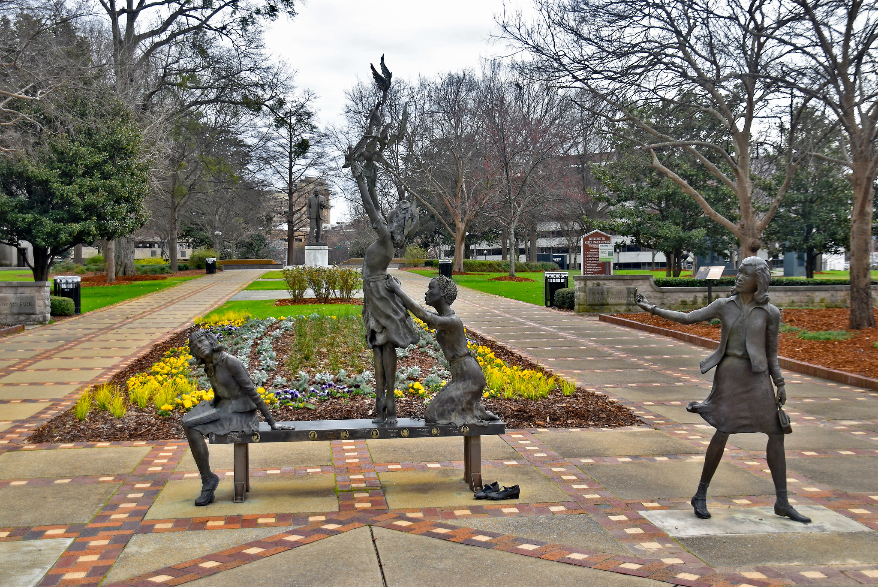
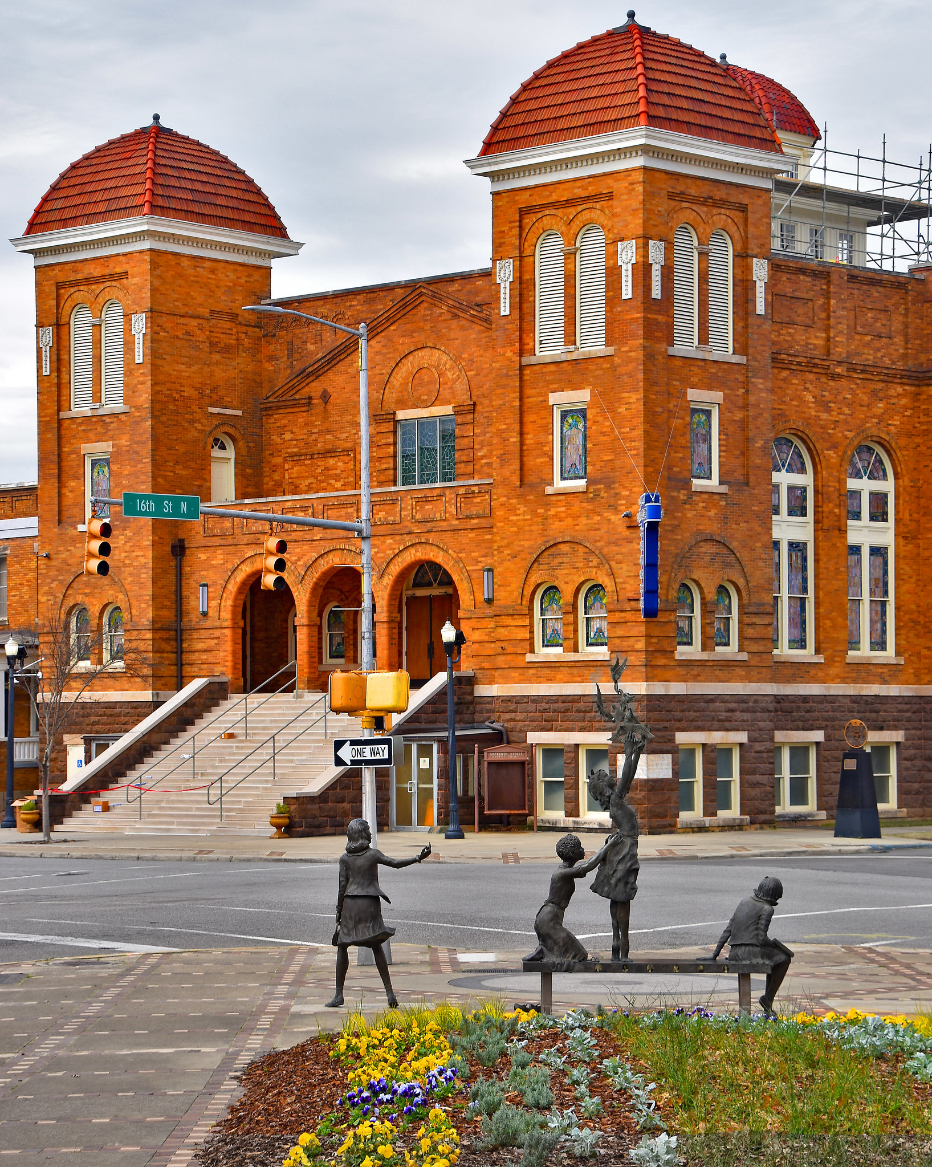
Site 8: Four Little Girls Listen Here
Next
Notes:
Alternative Method for Listening (Dial In):
Using your phone, call 205-307-5455
When prompted, press 8
Cogswell, R. (2019). 'The Four Spirits' (2013) by Elizabeth MacQueen -- Kelly Ingram Park Birmingham (AL) [Photograph]. Flickr. https://www.flickr.com/photos/22711505@N05/33521568488/. CC BY 2.0.
Cogswell, R. (2019). The 16th Street Baptist Church and Elizabeth MacQueen's 'The Four Spirits' (2013) -- Birmingham (AL) [Photograph]. Flickr. https://www.flickr.com/photos/22711505@N05/47344732962/. CC BY 2.0.

Slide 14
Site 8: Four Little Girls
At the end of the tour, there is a memorial to the four girls who were killed in the bombing of the 16th Street Baptist Church, months after the end of the Children’s Crusade. Why would this monument be included in the Kelly Ingram Park freedom walk?
Back to Map

