Slide 1
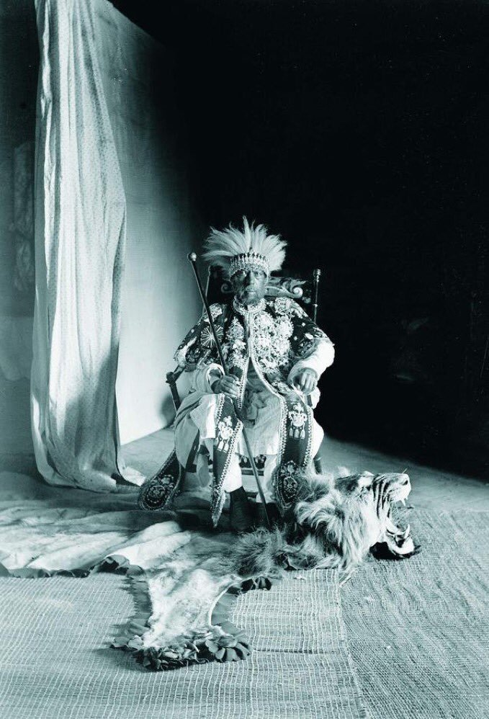


ETHIOPIAN
Independence
In the
Imperial Age
ኢትዮጵያ
Notes:
Image Source:
Emperor of Ethiopia Menelik II Negusä Nägäst. (n.d.). Wikimedia Commons. https://commons.wikimedia.org/wiki/File:Negusa_Nagast_Menelik_II_Emperor_of_Ethiopia.jpg. Public domain (CC0).

Slide 2
Quick Write 5 MIN
What does it mean to be victorious? A winner?
How do you know when you are victorious or when you have won? What do you do with your status as victor?
When you hear the word “winner” who is a person or entity you think of? Do you admire them? Why?

Slide 3
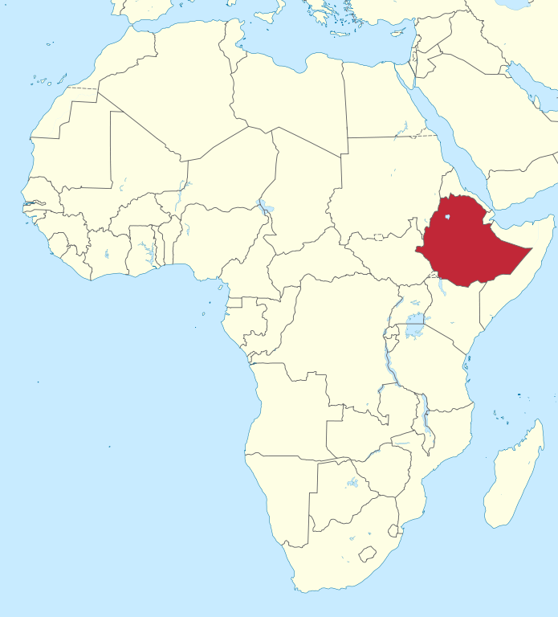
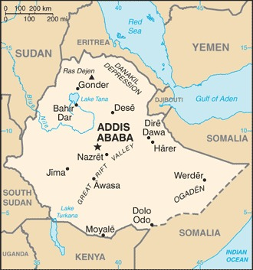
Ethiopia
(TUBS, 2011). CC BY-SA 3.0
Notes:
Image Sources:
Central Intelligence Agency. (2024). Ethiopia. In The World Factbook. https://www.cia.gov/the-world-factbook/countries/ethiopia/map/. Public Domain (CC0).
TUBS (2011, April 7). Ethiopia in Africa [Digital Image]. Wikimedia Commons. https://commons.wikimedia.org/wiki/File:Ethiopia_in_Africa_(-mini_map_-rivers).svg. CC BY-SA 3.0.

Slide 4
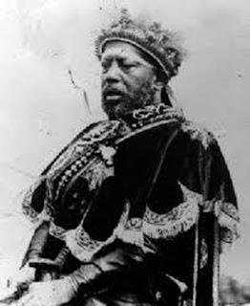
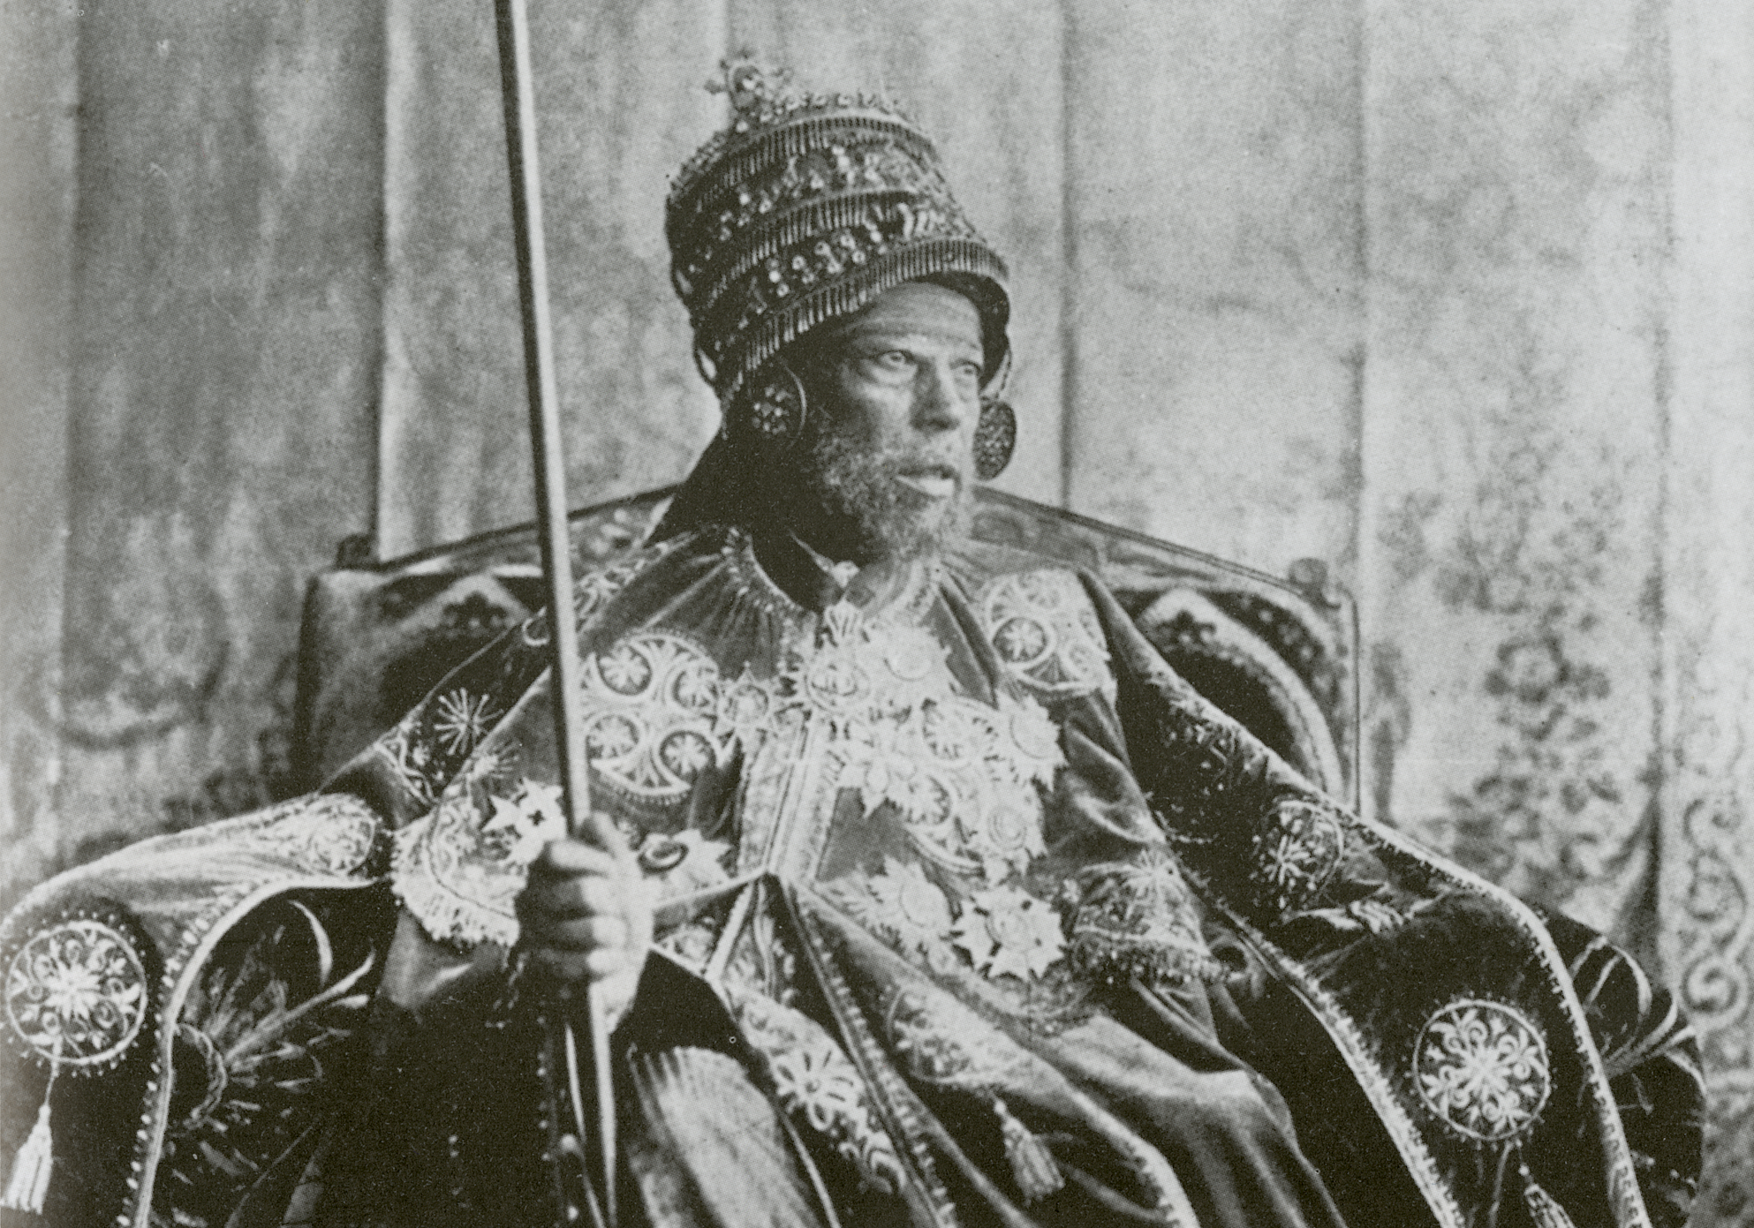
King Menelik II
Emperor of Ethiopia 1889-1913
Imprisoned for 10 years after his dad died to keep him from ruling
Named after the son of the Queen of Sheba (who ruled 3000 years before)
First ruler to unite African nations against European aggression (Italian)
Extended Ethiopia’s power in East Africa
Ruled Ethiopia at its strongest
Founded capital city, Addis Ababa
Founded first school, national bank, railway, telegraph system, telephone lines
Notes:
https://blogs.bl.uk/sound-and-vision/2019/10/black-history-month-king-menelik-and-queen-taytus-phonograph-message-to-queen-victoria.html
Image Sources:
Menelik II of Ethiopia Negusa Nagast (n.d.). Wikimedia Commons. https://commons.wikimedia.org/wiki/File:Menelik_II_of_Ethiopia_Negusa_Nagast.jpg. Public Doman (CC0).
Emperor Menelik II (n.d.). Wikimedia Commons. https://commons.wikimedia.org/wiki/File:Emperor_Menelik_II.png. Public Doman (CC0).

Slide 5
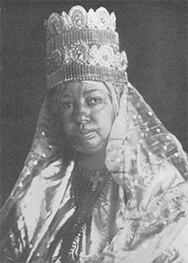
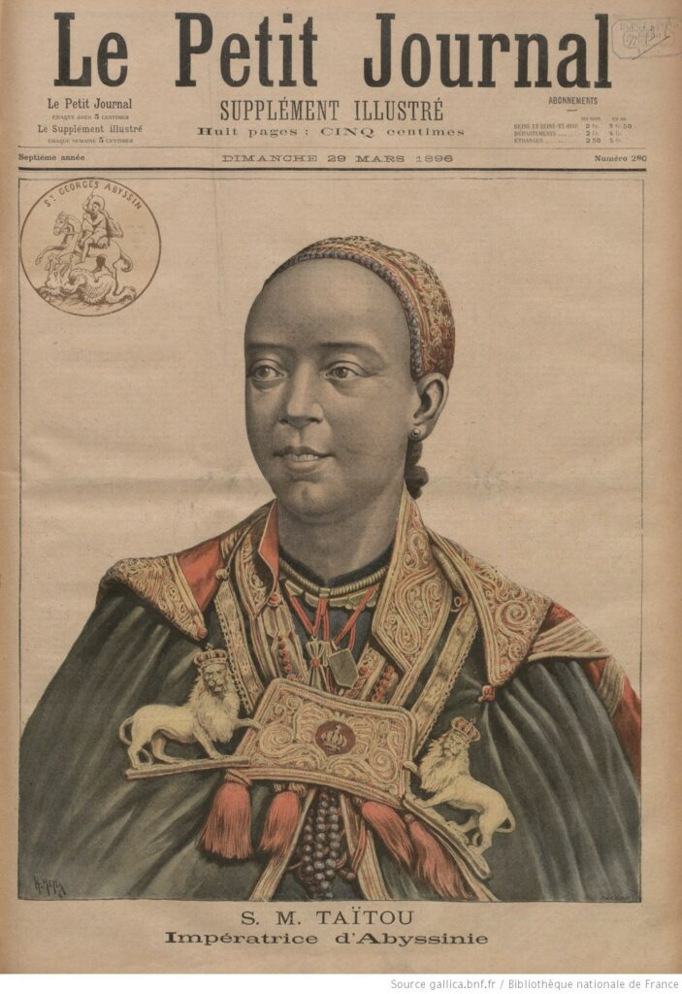
Queen Taytu
“The Light of Africa”
From a aristocratic family
Very familiar with politics and power structures, she was a natural leader
Chose the site for capital, founded a hotel, built a church, educated orphans, promoted trade and agriculture
Convinced Menelik to go to war
“Empress Taytu played a significant role in the process of unification [of Ethiopia]. She clarified issues for Menelik, and she had an individuality and warmth as a woman that was rarely seen by foreigners” - Italian member of Treaty delegation.
“My womanliness and your manliness is going to be tested on the battle field. Do not absent yourself!” - Queen Taytu to the Italians before battle
Notes:
https://blogs.loc.gov/international-collections/2022/03/taytu-betul-the-cunning-empress-of-ethiopia/
Image Sources:
Empress Taitu (n.d.). Wikimedia Commons. https://commons.wikimedia.org/wiki/File:Taicron.gif. Public Doman (CC0).
S. M. Taïtou Impératrice d’Abyssinie (1896, March 29). In Le Petit journal. Supplément du dimanche. Bibliothèque nationale de France. https://gallica.bnf.fr/ark:/12148/bpt6k716167b/f1.item. Public Doman (CC0).

Slide 6
Novel Ideas Only
On your whiteboard
Make a list of the natural resources available in Africa

Slide 7
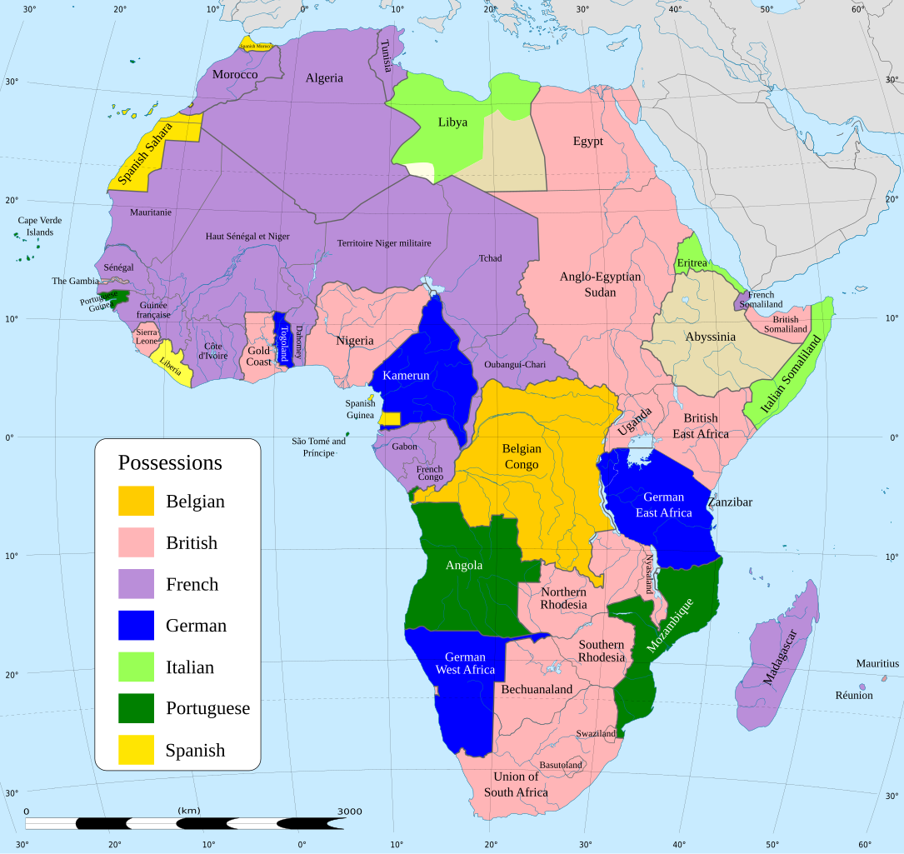
Ethiopia and Colonialism
What do you notice about Ethiopia?
Why was Ethiopia not colonized?
Notes:
Image Source:
[Map of Africa in 1914, depicting European colonial possessions]. (2023). Wikimedia Commons. https://commons.wikimedia.org/wiki/File:Africa_map_1914.svg. Public Doman (CC0).

Slide 8
Sources
Question 1

Slide 9
Ethiopia Questions
Question 1: Did Ethiopia have valuable resources?

Slide 10
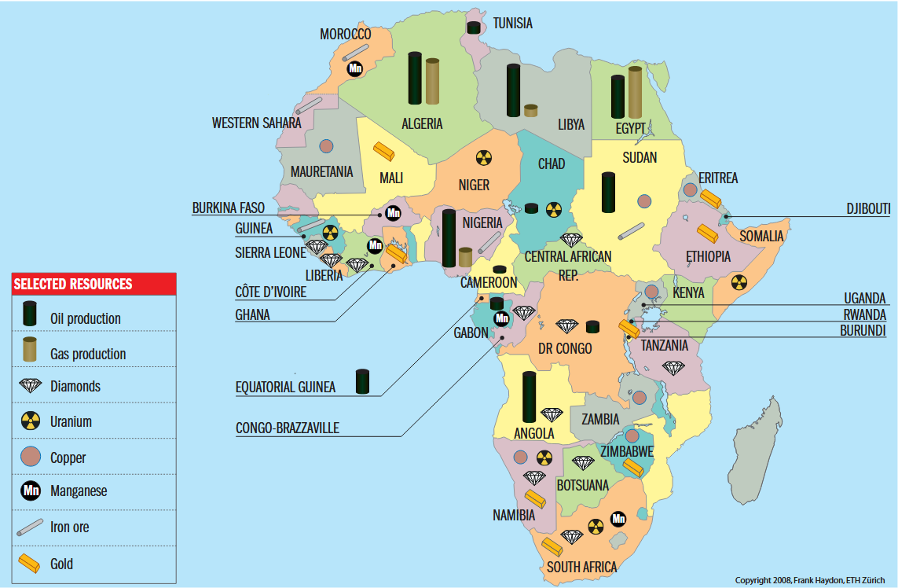
Africa: Natural Resources
Notes:
Image Source:
Haydon, F. (2008). Africa: natural resources [digital image]. In Giroux, J., Africa’s growing strategic relevance. CSS Analyses in Security Policy, 3(38), 1-3. ETH Zurich. https://www.files.ethz.ch/isn/56968/css_analysen_nr38-0708_E.pdf. © All rights reserved.

Slide 11
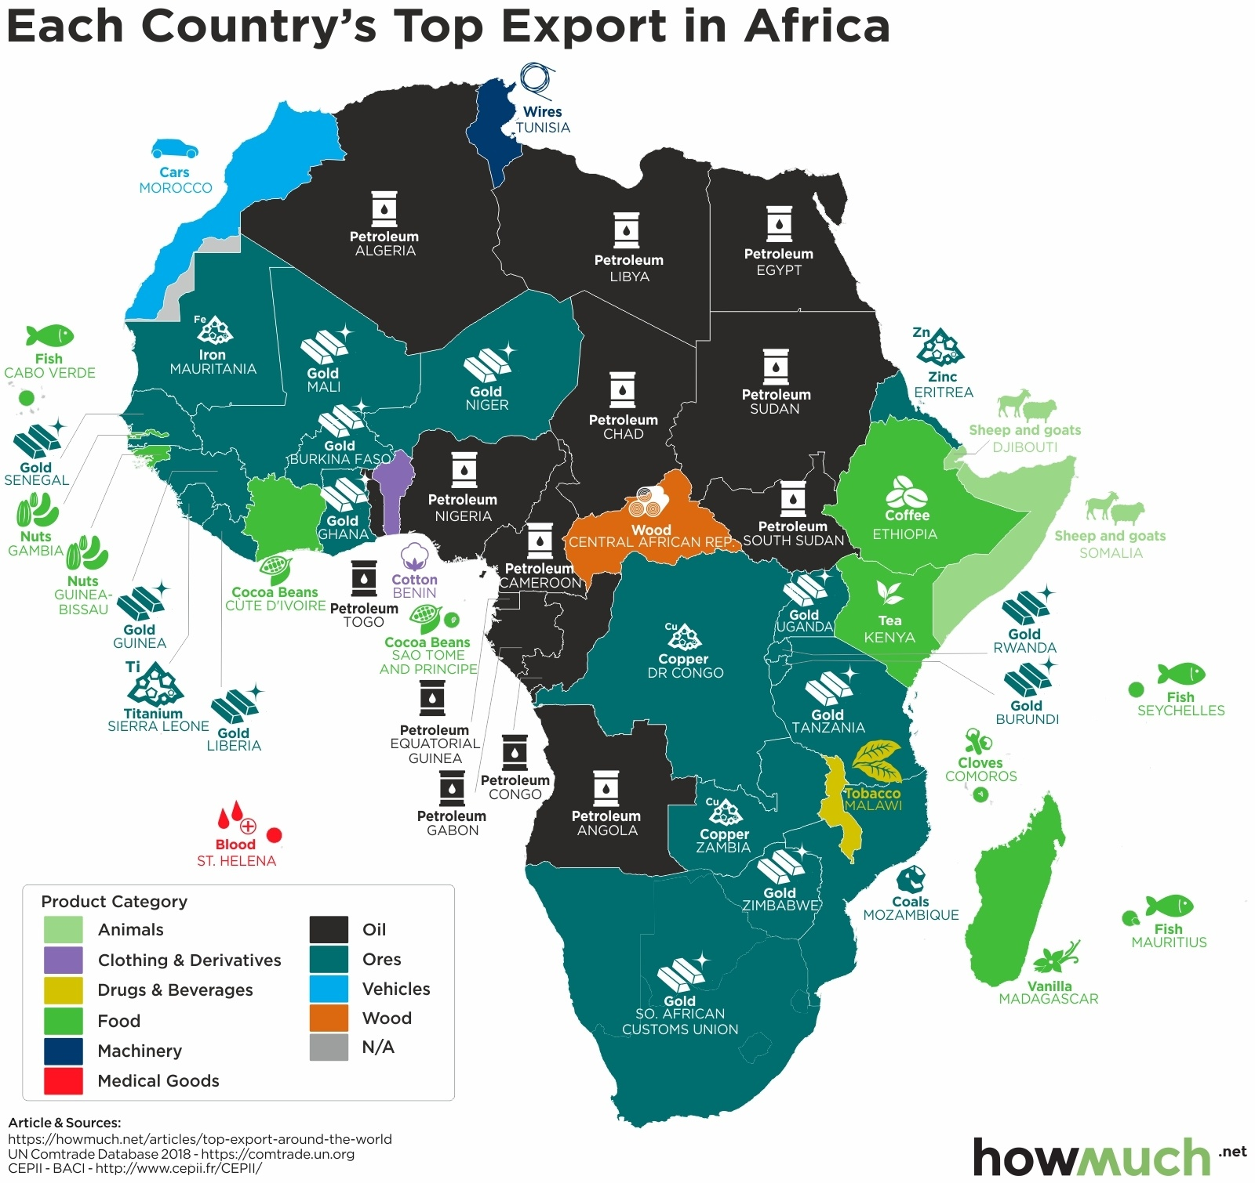
Each Country’s Top Export in Africa
Notes:
Image Source:
HowMuch.net (2020). These maps show every country’s most valuable export. https://howmuch.net/articles/top-export-in-every-country. © All rights reserved.

Slide 12
Europe v Ethiopia
Question 2: Did Ethiopia’s culture identify closely enough with Europe that “civilizing” was not needed?
What did Europeans pride themselves on; what made them feel superior or like they had to go dominate other parts of the world?
Gold? Glory? God? Fish? Furs? Forests? Missionaries? Militaries? Mercantilism? Whiteness?

Slide 13
Europe v Ethiopia T-chart
Look at each source and complete the T-chart comparing Ethiopians’ view of themselves with Europe’s view of Ethiopians
Groups of 4-6

Slide 14
Sources
Question 2

Slide 15
King Menelik II’s call to arms
“Now an enemy that intends to destroy our homeland and change our religion has come crossing our God-given frontiers digging in like a mole. Now, with the help of God, I will not allow him to have my country. You, my countrymen, I have never knowingly hurt you, nor have you hurt me. Help me, those of you with zeal and will power; those who do not have the zeal, for the sake of your wives and your religion, help me with your prayers.” (1896 declaration recorded by Battle of Adwa eyewitness, Gebre Selassie).

Slide 16
2. King Menelik II’s declaration of blackness
“I am black, and you are black; let us unite to hunt our common enemy.” (1895 quote when trying to convince Muslims to help fight imperial Italy).

Slide 17
3. Kebra Nagast
This is a collection of stories, history, myths, legends of Abyssinia/Ethiopia that explains how the kings of Ethiopia are descended from the son, named Menelik, of Israel’s King Solomon and the Queen of Sheba, making them relatives of the divine line of Christ and closely related to the Semitic peoples of Asia. It even claims that the Ark of the Covenant was taken to Ethiopia because the Jews were not worthy to care for it. It was collected and written over the centuries in several languages due to conquest and eventually translated into Ethiopian in the Middle Ages. Use some or all of the following quotes and excerpts from the Kebra Nagast to illustrate Ethiopia’s proud Christian heritage. For complete source, see lesson plan.
The introduction to the Kebra Nagast states “IN PRAISING GOD THE FATHER, THE SUSTAINER OF THE UNIVERSE, AND HIS SON JESUS CHRIST, THROUGH WHOM EVERYTHING CAME INTO BEING, AND WITHOUT WHOM NOTHING CAME INTO BEING, AND THE HOLY TRIUNE SPIRIT, THE PARACLETE, WHO GOETH FORTH FROM THE FATHER, AND DERIVETH FROM THE SON, WE BELIEVE IN AND ADORE THE TRINITY, ONE GOD, THE FATHER, AND THE SON, AND THE HOLY SPIRIT.”
Chapter 28 states: On one of her visits to Solomon, she [the queen] devoted her life to the God of Israel. “And the Queen said, "From this moment I will not worship the sun, but will worship the Creator of the sun, the God of ISRAEL. And that Tabernacle of the God of ISRAEL shall be unto me my Lady, and unto my seed after me, and unto all my kingdoms that are under my dominion. And because of this I have found favour before thee, and before the God of ISRAEL my Creator, Who hath brought me unto thee, and hath made me to hear thy voice, and hath shown me thy face, and hath made me to understand thy commandment." Then she returned to [her] house.”

Slide 18
4. Edmund Burke (British statesman) quote, 1777
“Now the Great Map of Mankind is unrolled at once; and there is no state or Gradation of barbarism, and no mode of refinement which we have not at the same instant under our View. The very different Civility of Europe and of China; the barbarism of Persia and Abyssinia [Ethiopia], the erratic manners of Tartary, and of Arabia. The Savage state of North America, and of New Zealand.”

Slide 19
5. Count Peitro Antonelli on Queen Taytu
“The Empress like all other Ethiopian women is brave. She had a strong character, sometimes haughty-and is interesting appearance. Her look is commanding and at the same time has finesse…In sum, she is a great lady, who perhaps in another milieu [social class or situation] would have been a Christina of Sweden or a Catherine the Great.”

Slide 20
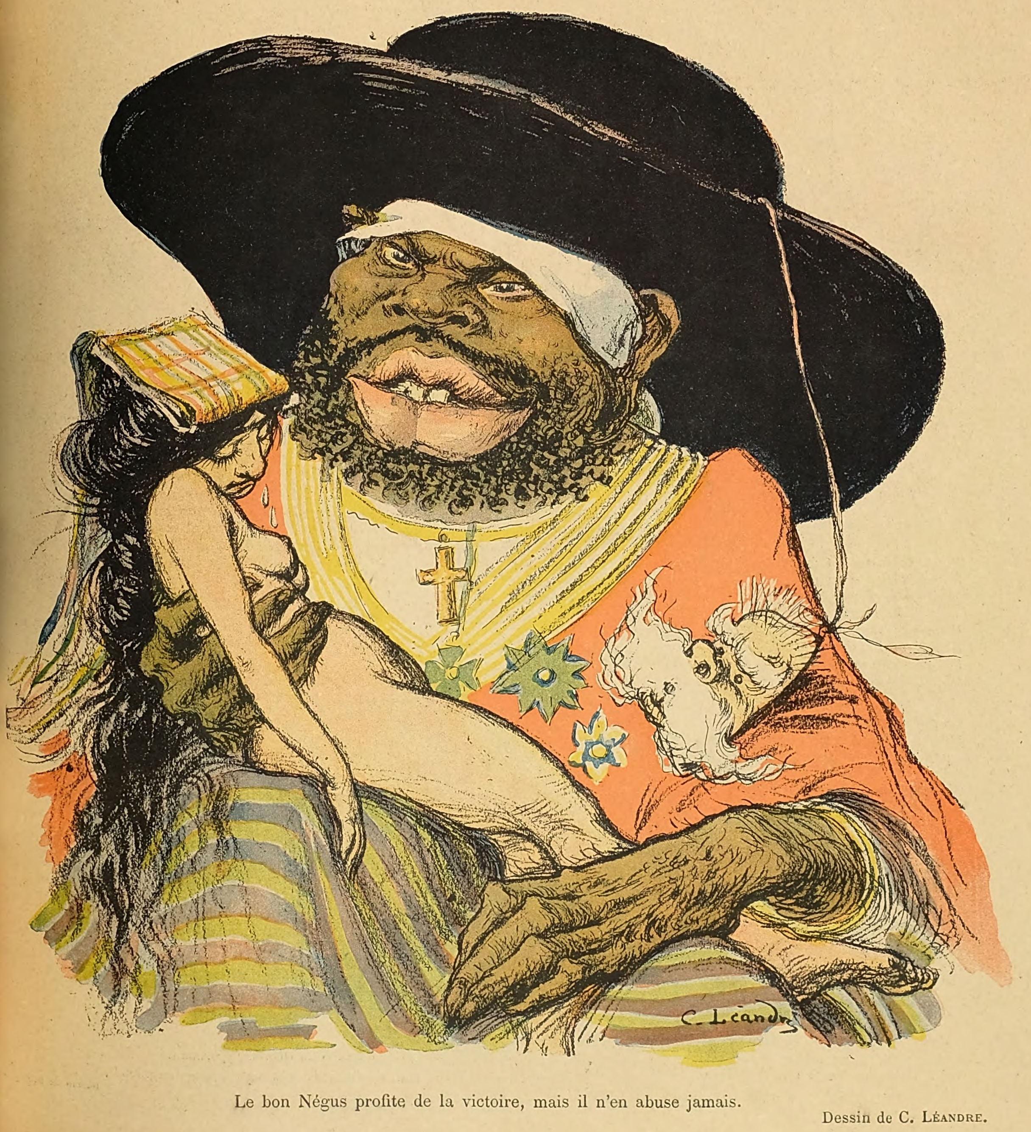
6. Charles Leandre (French cartoonist)
cartoon of King Menelik II after his defeat of Italy, late 1800s. Italy is the woman held in Menelik’s arms.
Notes:
Image Source:
Leandre, C. (1897, September 25). [Cartoon of King Menelik II after his defeat of Italy]. Le Rire: journal humoristique paraissant le samedi. https://babel.hathitrust.org/cgi/pt?id=hvd.hn4kyv&seq=493. Public domain (CC0).

Slide 21
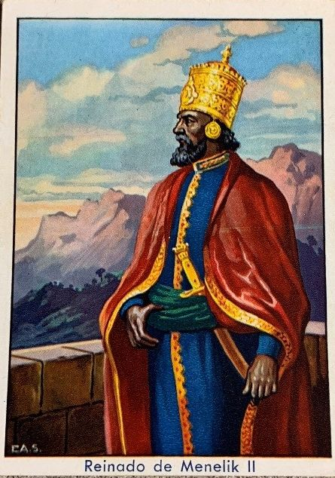
7. Spanish artist rendition of King Menelik after victory over Italy, 1896.
Notes:
Image Source:
[Imagination of a Spanish artist of the triumphant emperor, Menelik II]. (1896). Library of Congress African and Middle Eastern Division, Ethiopian Collection of Trade Cards. https://blogs.loc.gov/international-collections/2020/03/emperor-menelik-ii-of-ethiopia-and-the-battle-of-adwa-a-pictorial-history/?loclr=fbint. Public domain (CC0).

Slide 22
Ethiopia v Europe Military
Question 3: Did Ethiopia have a superior political and military situation from 1884-1914?
Examine the source you are given and complete the part of the chart that corresponds to your source. DO NOT SUMMARIZE. Prepare to share with others.
Groups of 4-6

Slide 23
Sources
Question 3

Slide 24
King Menelik’s letter to the caliph of the Sudan
“This is to inform you that the Europeans who are present round the White Nile with the English have come out from both the east and the west, and intended to enter between my country and yours and to separate and divide us. And I, when I heard of their plan, dispatched an expedition, sending detachments in five directions. The group [of Europeans] who are near are the English and the French, who are located in the direction from which the Belgians came. And do you remember when I sent to you Kantiba Jiru, you wrote to me by him that you have men in the direction from which the Belgians came?; and I ordered the chiefs of [my] troops that if they met with them, they were to parley with them and explain [my] intention. And now I have ordered my troops to advance towards the White Nile. And perhaps [if] you heard the news from merchants or from others you might misunderstand my action, [so now] I have written to you so that you would understand the object [of this expedition]. And you look to yourself, and do not let the Europeans enter between us. Be strong, lest if the Europeans enter our midst a great disaster befall us and our children have no rest. And if one of the Europeans comes to you as a traveler, do your utmost to send him away in peace; and do not listen to rumors against me. All my intention is to increase my friendship with you, and that our countries may be protected from [their] enemies.”

Slide 25
King Menelik’s recording to Queen Victoria, 1899
Queen Victoria’s phonograph recording to King Menelik and his wife, the empress. England (and Europe in general) sought alliances with Ethiopia to check the spread of the Ottoman empire.“I, Victoria, Queen of England, hope your Majesty is in good health. I thank you for the kind reception which you have given to my Envoys, Mr. Rodd and Mr. Harrington. I wish your Majesty and the Empress Taitou all prosperity and success, and I hope that the friendship between our two Empires will constantly increase.”
King Menelik’s response: “I, Menelik II, king of kings of Ethiopia, say to our very honoured friend Victoria, Queen of the great English people, 'May the Saviour of the World give you health! When the very beautiful and excellent phonograph (recording) of the Queen reached me by the hands of Monsieur Harrington and when I heard the voice of Your Majesty (as if) you were beside me, I listened with great pleasure. May God thank you for your good wishes for us and for my kingdom. May God give you long life and health and give your people peace and repose. I have spoken with M. Harrington concerning all issues between both our peoples. When he told me that he was now returning to England, I said to him that I would be pleased if he could settle all our affairs before coming back. And now, may the Queen receive him well. Furthermore, we have told M. Harrington about Matamma, how our great king is and many of our compatriots died there for their religious zeal. I have hopes that you will help us in having the English government recognize this city for us.May God help us that Ethiopia and England may remain in peace and friendship. Having said this, I extend my greetings of respect to your great people.”
Queen Taytu’s response: “I, Itege (Queen) Taitu, Light of Ethiopia, say to the very honoured Queen Victoria, the great Queen of the English... May God give you health. Your phonograph has reached me. With great pleasure I listened to you (as if) you were beside me. And now, since God has willed to bring my voice to the ear of the honoured Queen, I declare ... that God give you health and long life. May God keep you many years in good health.”

Slide 26
King Menelik’s letter to European heads of state explaining Ethiopia’s borders, written to Britain, France, Germany, Italy and Russia, 1891
Being desirous to make known to our friends the Powers (Sovereigns) of Europe the boundaries of Ethiopia, we have addressed also to you (your Majesty) the present letter.
These are the boundaries of Ethiopia:-Starting from the Italian boundary of Arafale, which is situated on the sea, the line goes westward over the plain (Meda) of Gegra towards Mahio, Halai, Digsa, and Gura up to Adibaro. From Adibaro to the junction of the Rivers Mareb and Arated.
From this point the line runs southward to the junction of the Atbara and Setit Rivers, where is situated the town known as Tomat.
From Tomat the frontier embraces the Province of Gederef up to Karkoj on the Blue Nile. From Karkoj the line passes to the junction of the Sobat River with the White Nile. From thence the frontier follows the River Sobat including the country of Arbore, Gallas and reaches Samburu.
Towards the east are included within the frontier the country of the Borana Gallas and Arussi country up to the limits of the Somalis, including also the Province of Ogaden.
To the northward the line of the frontier includes the Habar Awal, the Gadabursi, and Essa Somalis , and reaches Ambos.
Leaving Ambos the line includes Lake Assal, the province of our ancient vassal Mohamed Anfari, skirts the coast of the sea, and rejoins Arafale. While tracing today the actual boundaries of my Empire, I shall endeavour, if God gives me life and strength, to re-establish the ancient frontiers (tributaries) of Ethiopia up to Khartoum, and as Lake Nyanza with all the Gallas.
Ethiopia has been for fourteen centuries a Christian island in a sea of pagans. If powers at a distance come forward to partition Africa between them, I do not intend to be an indifferent spectator.
As the Almighty has protected Ethiopia up to this day, I have confidence He will continue to protect her, and increase her borders in the future . I am certain He will not suffer her to be divided among other Powers.
Formerly the boundary of Ethiopia was the sea. Having lacked strength sufficient, and having received no help from Christian Powers, our frontier on the sea coast fell into the power of the Muslim-man.
At present we do not intend to regain our sea frontier by force, but we trust that the Christian Power, guided by our Saviour, will restore to us our sea-coast line, at any rate, certain points on the coast. Written at Addis Ababa, the 14 th Mazir, 1883 (10th April, 1891).

Slide 27
Treaty of Wuchale, 1889
Article 17 in Amharic states: “his Majesty the King of Kings of Ethiopia can use the Government of His Majesty the King of Italy for all treatments that did business with other powers or governments.”
Article 17 in Italian states: “his Majesty the King of Kings of Ethiopia must use the Government of His Majesty the King of Italy for all treatments that did business with other powers or governments.”

Slide 28
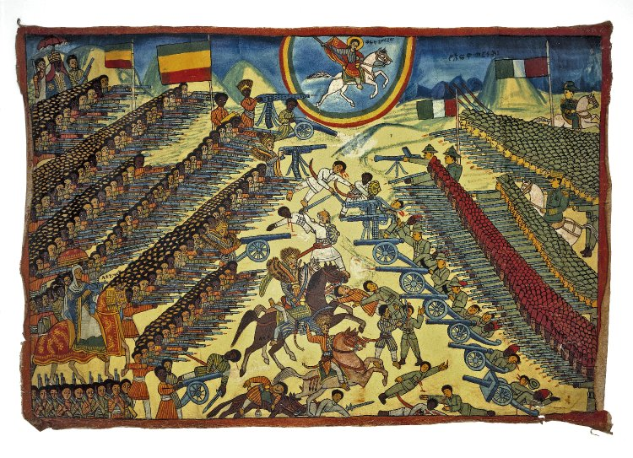
Battle of Adwa
The Trustees of the British Museum, CC BY-NC-SA 4.0
Notes:
Image Source:
[Untitled oil painting depicting the battle of Adwa, March 2, 1896]. (1940-1949). The Trustees of the British Museum. https://www.britishmuseum.org/collection/image/72427001. CC BY-NC-SA 4.0.

Slide 29
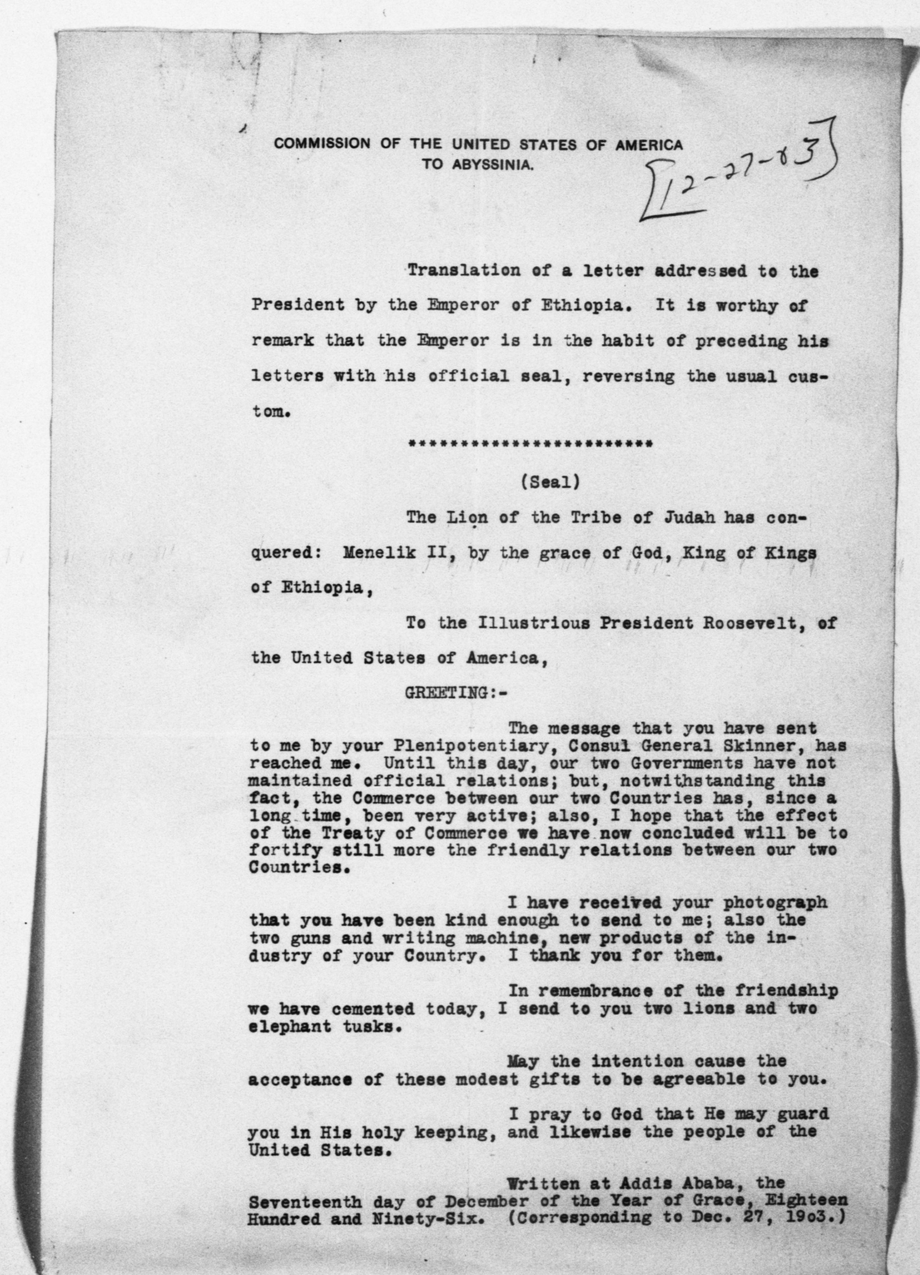
King Menelik’s letter to President Roosevelt, 1903
Notes:
Image Source:
Menelik II, (1903, December 17). Translation of letter from Emperor Menelik II to Theodore Roosevelt. Theodore Roosevelt Papers. Library of Congress Manuscript Division. https://www.theodorerooseveltcenter.org/Research/Digital-Library/Record?libID=o43319. Public domain (CC0).

