Slide 1
Teachers should use an example from a community that is local or relevant to their students. The Slides provided here are meant to provide a framework for how to introduce a current primary source example and discussion questions.

Slide 2
Student Protest in Our Community
How are students and children impacting public policy in our local community?

Slide 3
Directions
Read the News-Register article, Student-led protest takes on racism, police brutality
Discuss:
What role did students have in the protest example here?
Compare and contrast: How is this similar to the role of students in the civil rights movement? How is it different?
How are students and children impacting public policy in our local community?

Slide 4
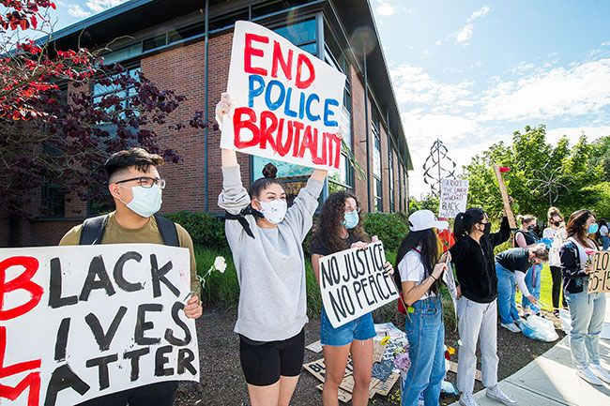
Protest organizer Cecilia Flores leads the crowd in cheers during a large Tuesday gathering outside the McMinnville police station. Flores and many other McMinnville High School students were in the crowd of hundreds
Notes:
Image Source:
Larson, M. (2020, June 2). Protest organizer Cecilia Flores leads the crowd in cheers during a large Tuesday gathering outside the McMinnville police station. Flores and many other McMinnville High School students were in the crowd of hundreds [photograph]. News-Register.

Slide 5
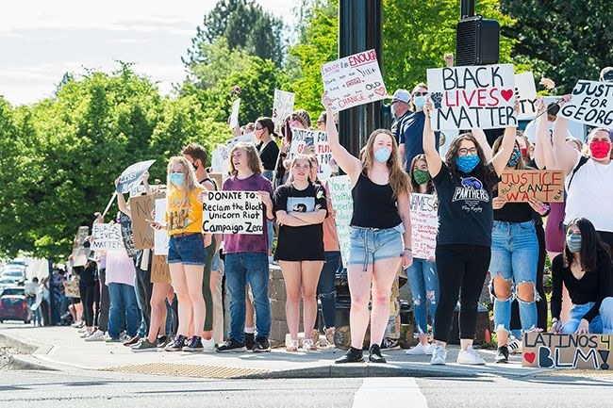
Hundreds showed up for Tuesday’s Black Lives Matter protest, standing on the four corners of the Second and Adams intersection in McMinnville.
Notes:
Image Source:
Larson, M. (2020, June 2). Hundreds showed up for Tuesday’s Black Lives Matter protest, standing on the four corners of the Second and Adams intersection in McMinnville [photograph]. News-Register.

Slide 6
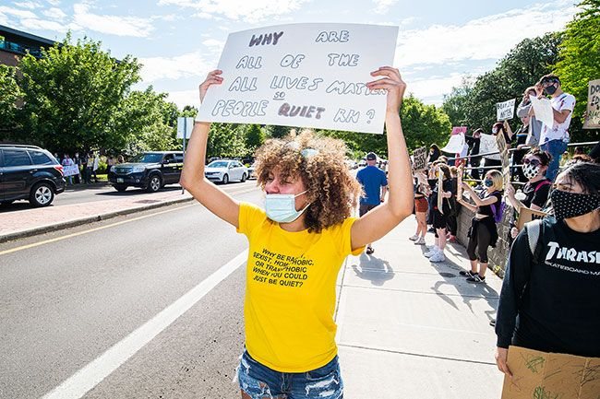
Stephanie Willis holds up a sign questioning those to [sic] respond to “Black Lives Matter” with “All Lives Matter.”
Notes:
Image Source:
Larson, M. (2020, June 2). Stephanie Willis holds up a sign questioning those to [sic] respond to “Black Lives Matter” with “All Lives Matter” [photograph]. News-Register.

Slide 7
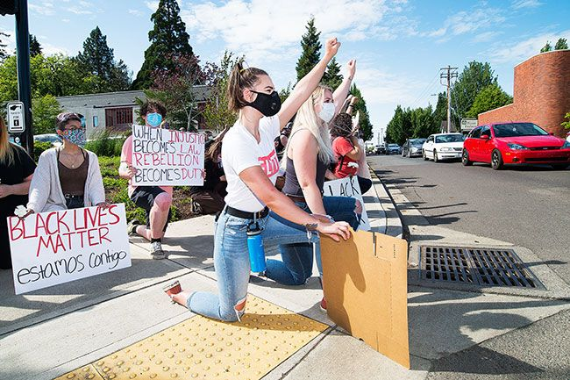
During the Tuesday protest, Lydia Doughty and Lexie McKinley each take a knee with the rest of the crowd in support of the BLM movement.
Notes:
Image Source:
Larson, M. (2020, June 2). During the Tuesday protest, Lydia Doughty and Lexie McKinley each take a knee with the rest of the crowd in support of the BLM movement [photograph]. News-Register.

Slide 8
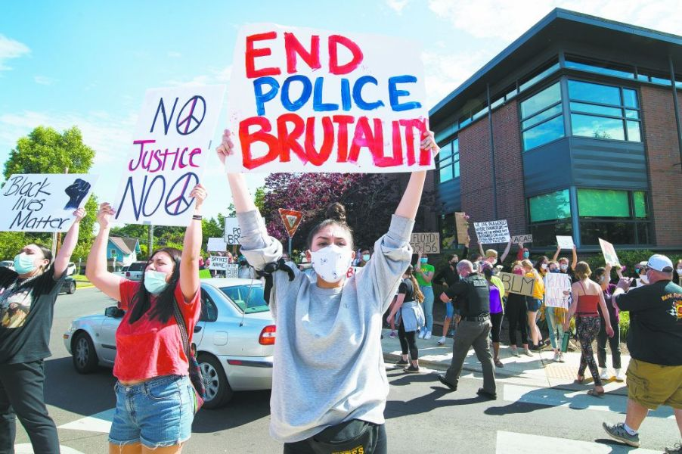
Protesters, including organizer Cecilia Flores, center, gathered in McMinnville on Tuesday afternoon.
Notes:
Image Source:
Larson, M. (2020, June 2). Protesters, including organizer Cecilia Flores, center, gathered in McMinnville on Tuesday afternoon [photograph]. News-Register.

Slide 9
Sources
Totoian, D. (2020, June 5). Student-led protest takes on racism, police brutality. News-Register (McMinnville, OR) .

